Slide 1
Bus Booking System
By
Madan KishORE n
727822tucs106

Slide 2
Agenda:
Description
Configuration
Model
Repository
Service
Controller

Slide 3
Description
Our Bus Booking Application is a comprehensive solution built using Spring Boot, designed to facilitate toy management and sales for both customers and administrators.
The application offers a user-friendly interface and robust functionality to cater to the diverse needs of toy enthusiasts and store owners alike.
KEY FEATURES :
PRODUCT MANAGEMENT :
Administrators can easily add, update, and delete Booking of the Buses
Each Buses entry includes details such as name, description, price.
USER MANAGEMENT :
Customers can create accounts, allowing them to track their bookings and manage their profiles.
ORDER PROCESSING :
Customers can brows the available buses, add them to user’s list by relationship and travel through their wish buses…

Slide 4
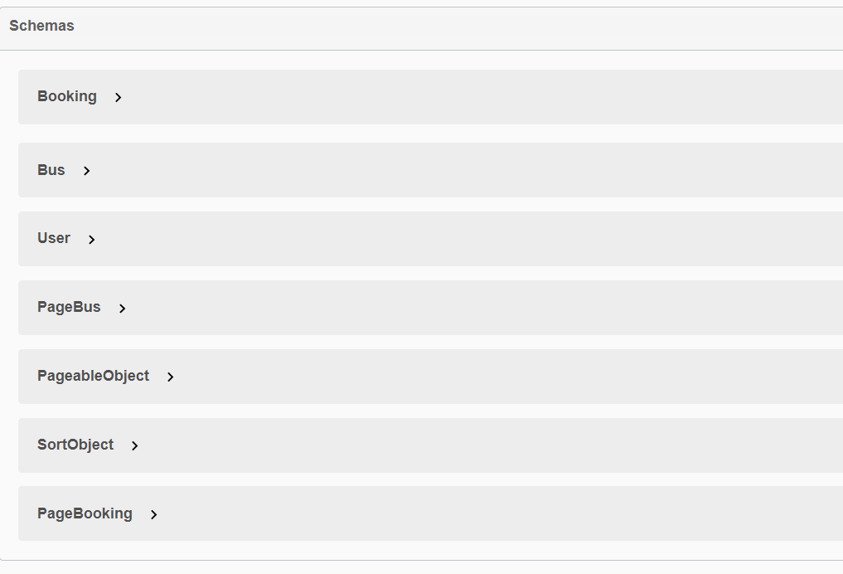
Schemas:

Slide 5
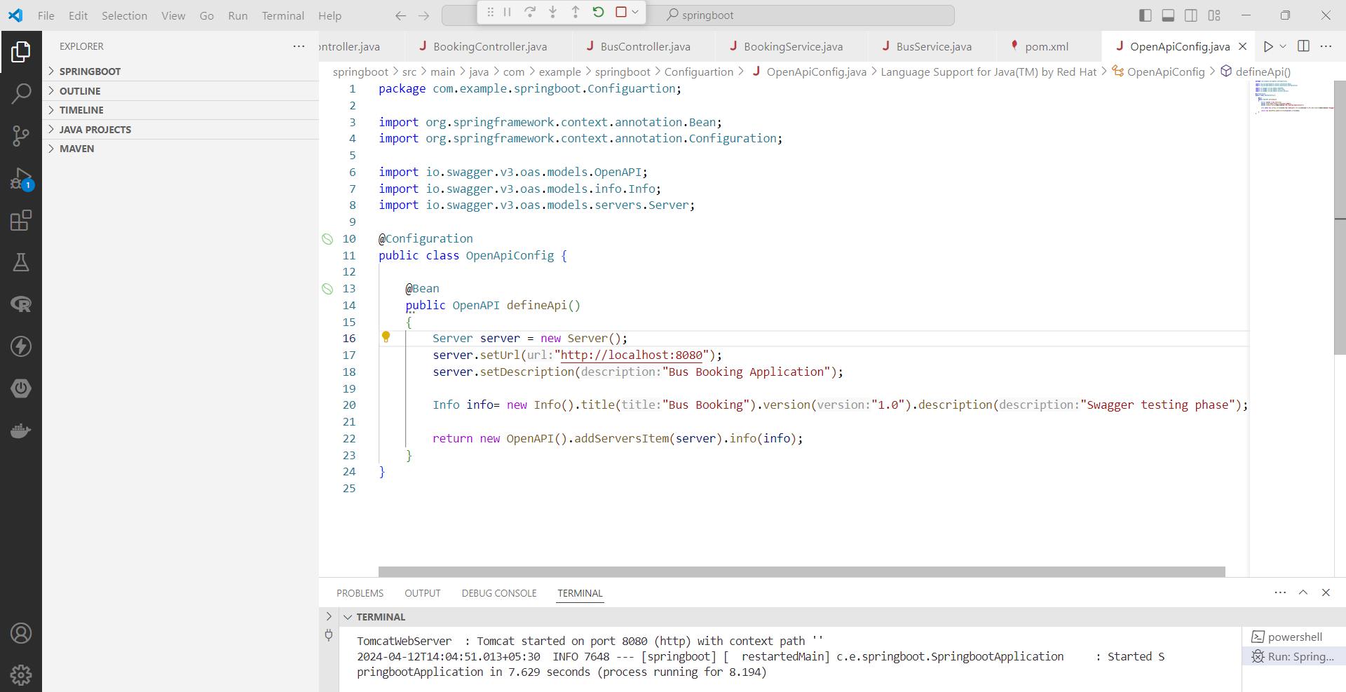
Configuration :

Slide 6
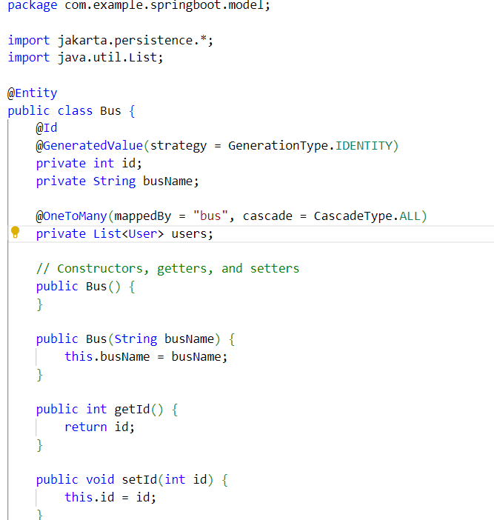
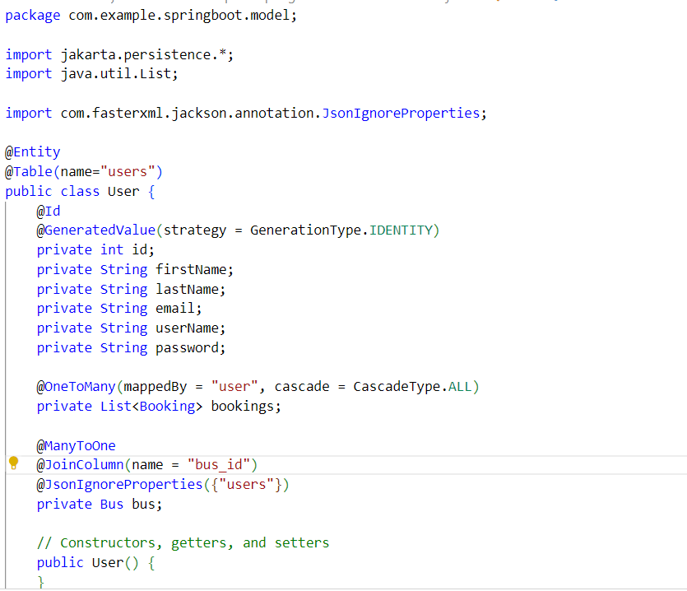
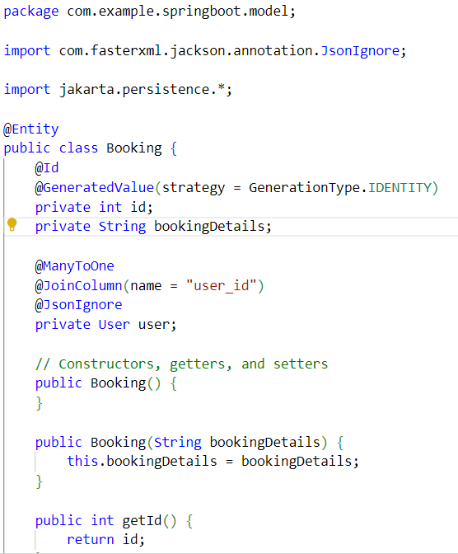
Model

Slide 7
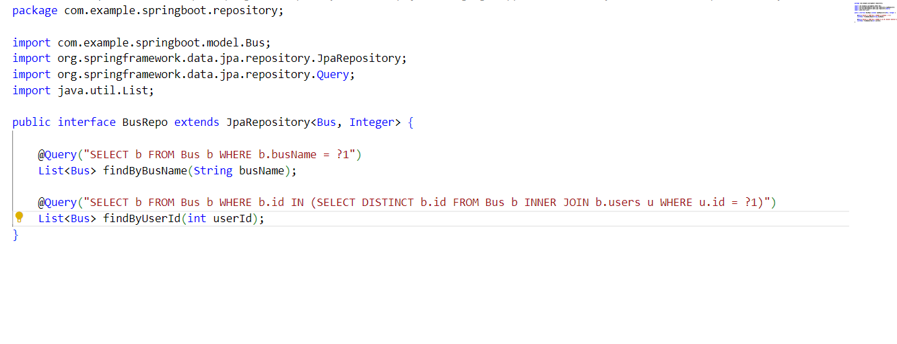
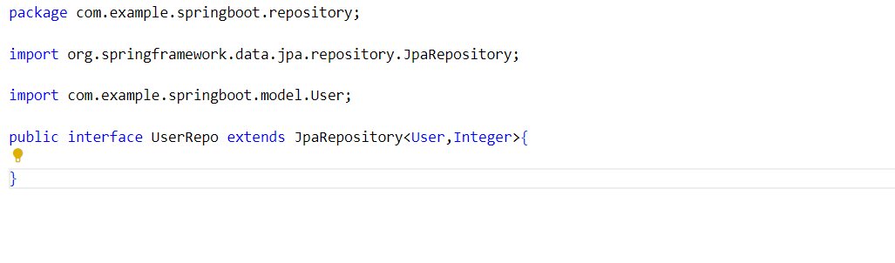
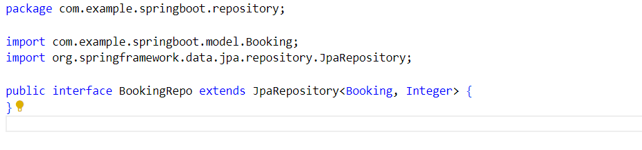
Repository :

Slide 8
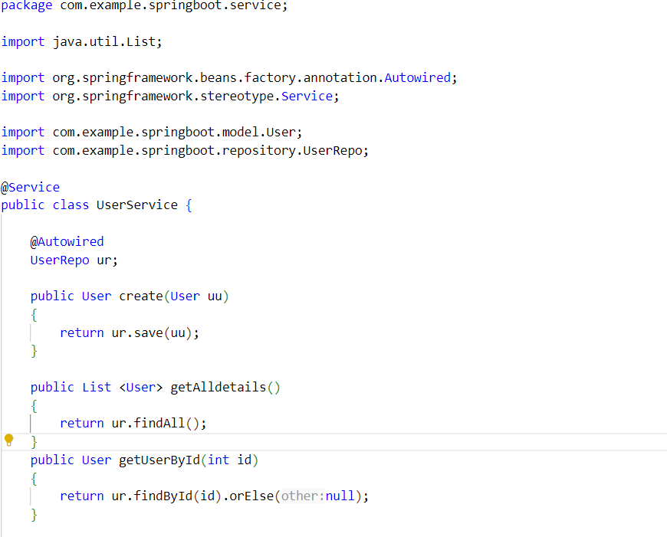
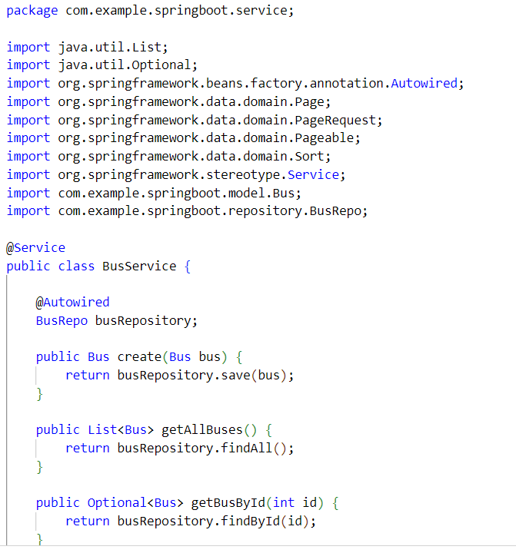
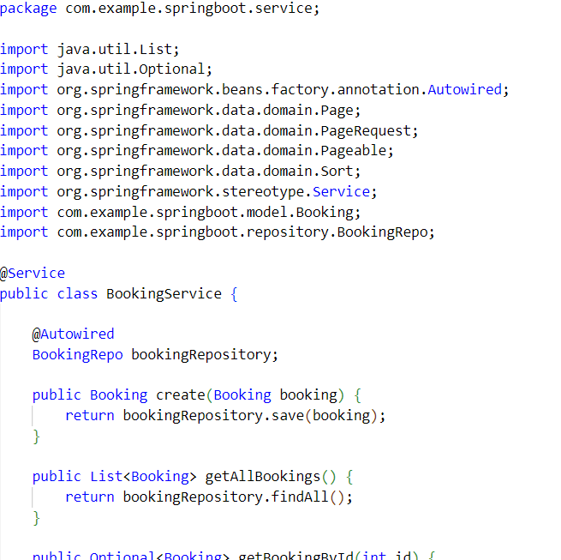
Service

Slide 9
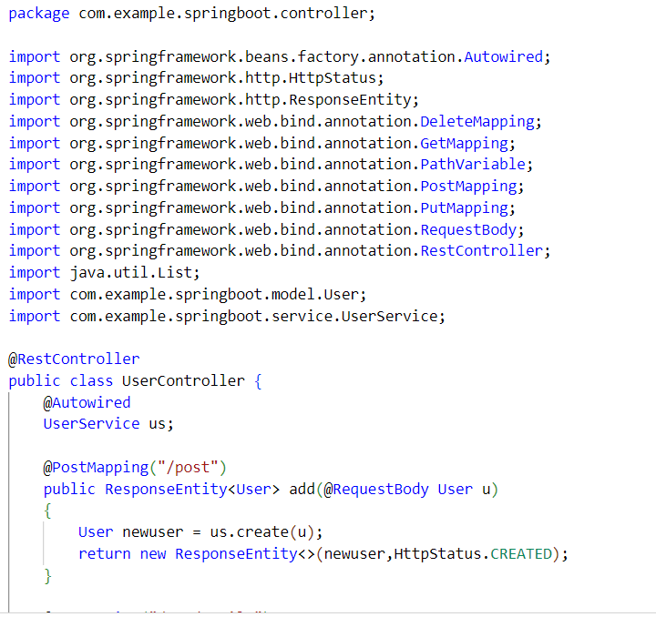
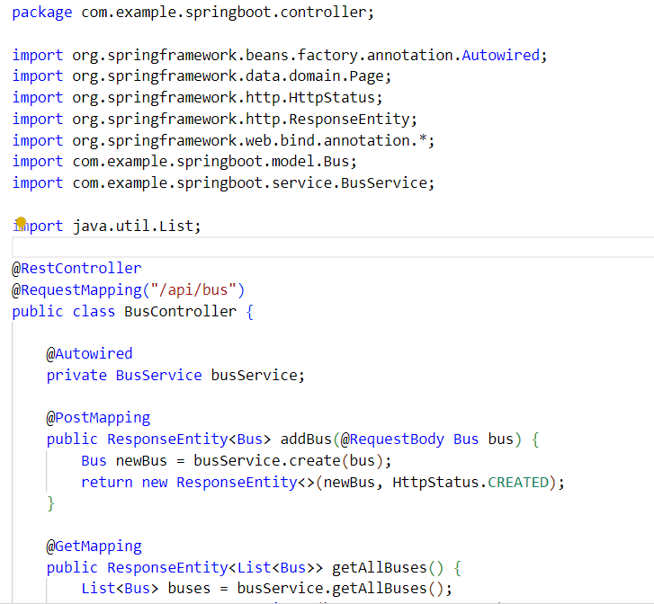
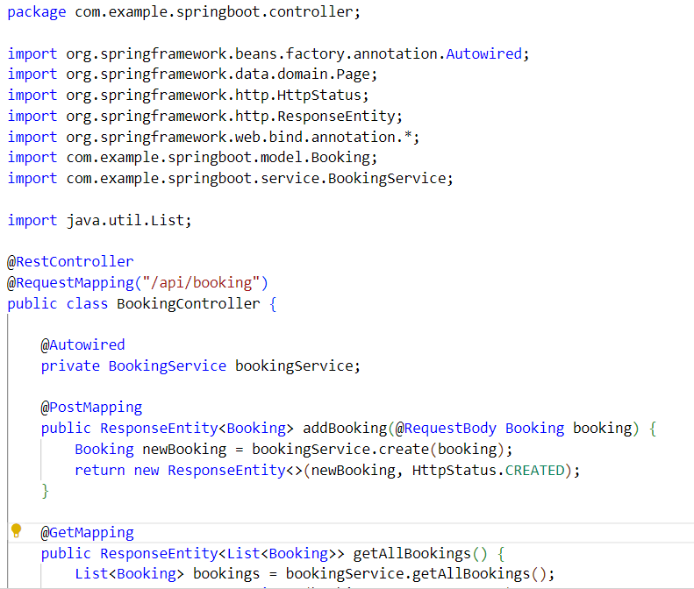
Controller

Slide 10
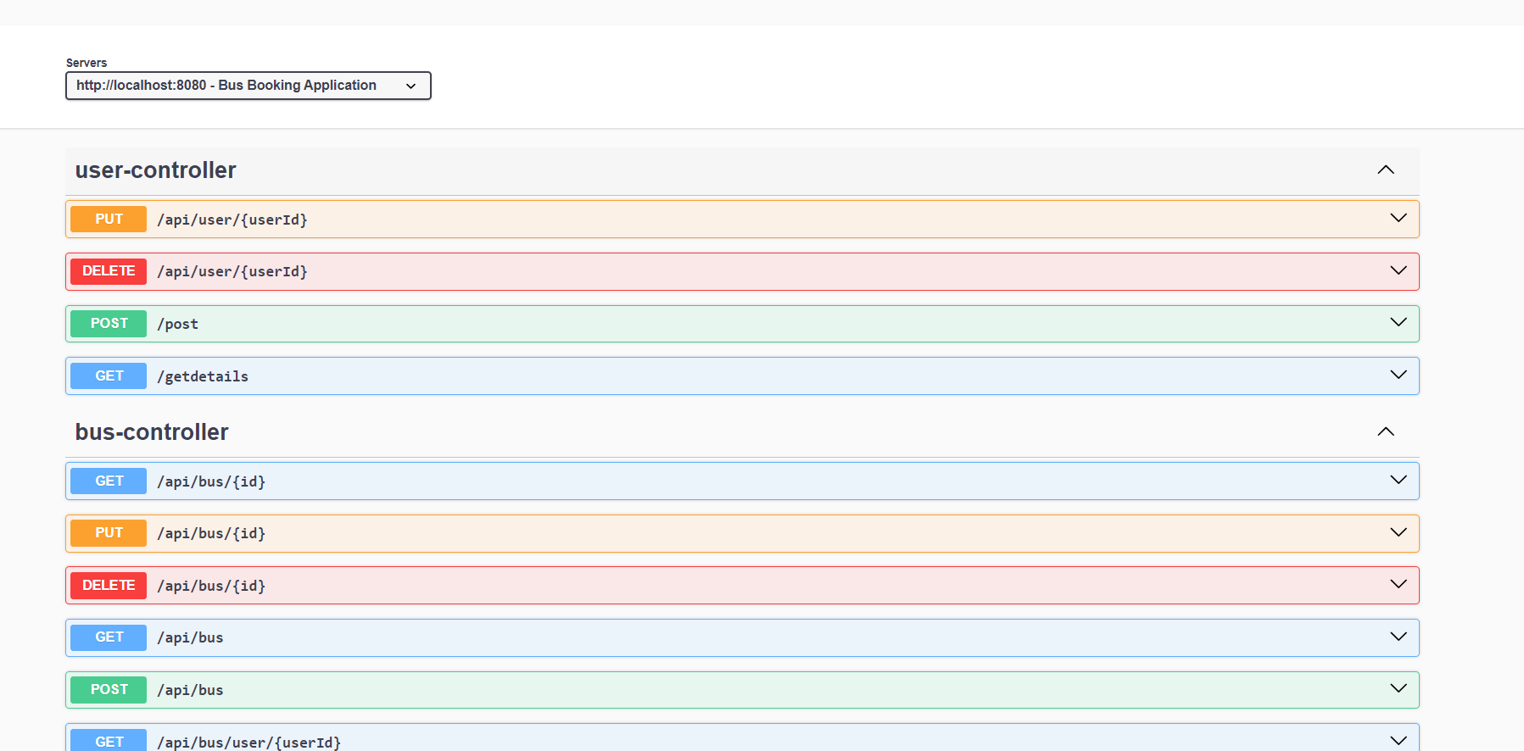
Use-Cases

Slide 11
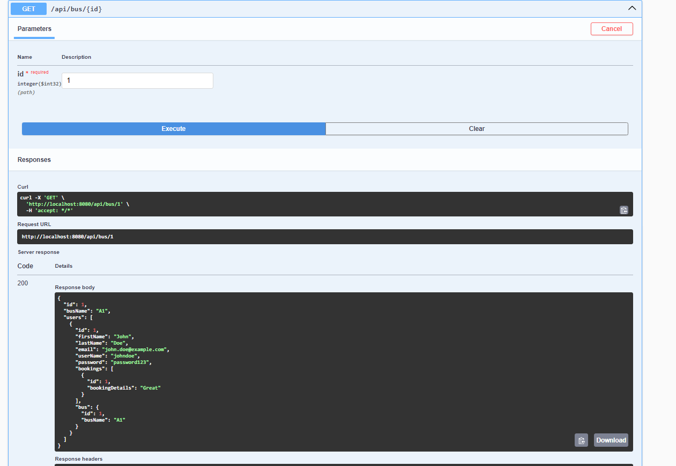
Output

Slide 12
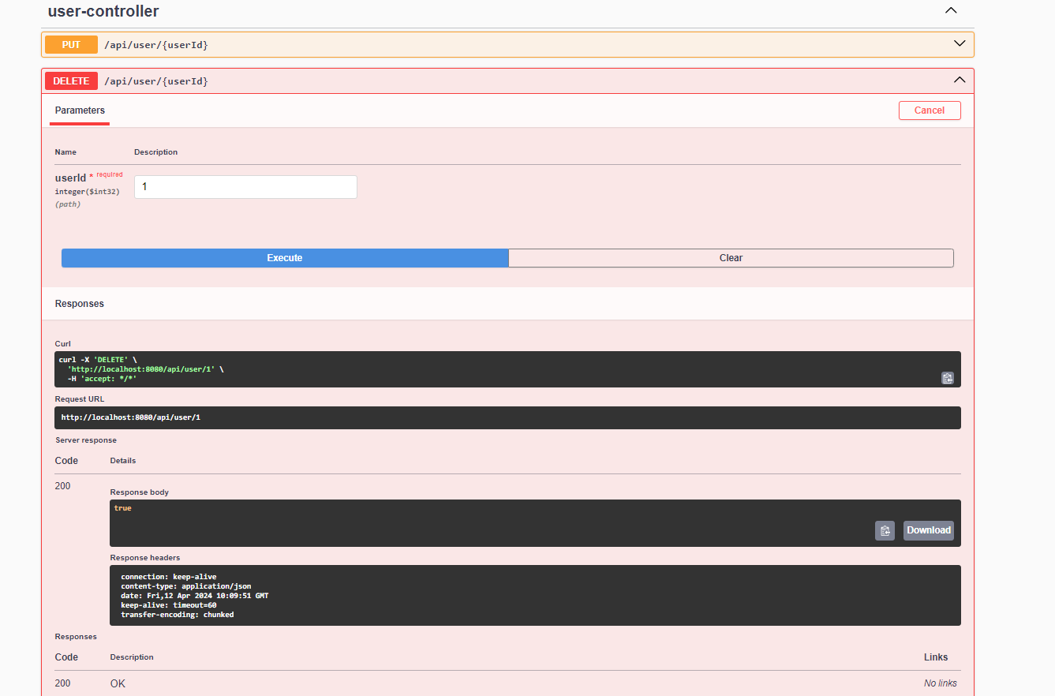

Slide 13
Thank You!!
BY
MADAN KISHORE N
II CSE B

